Slide 1
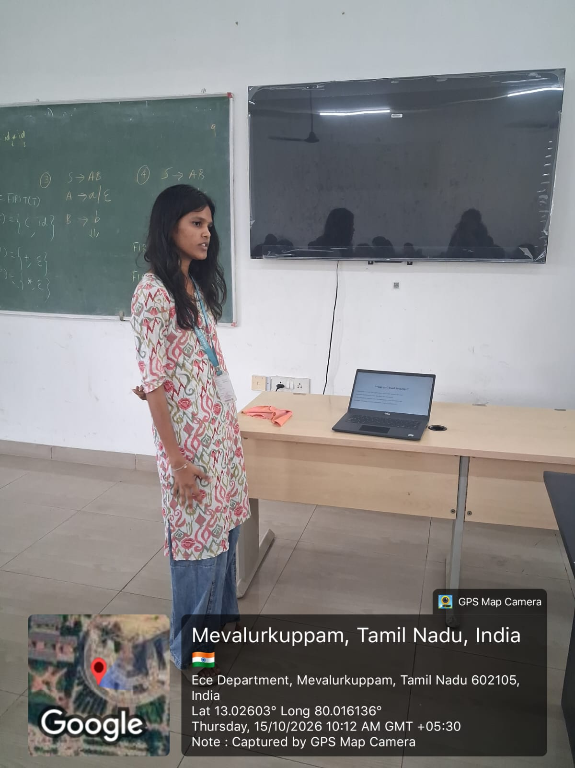

Slide 2
Cloud Security Fundamentals: Protecting Data and Applications
Security Models
Shared Responsibility
Real-World Security Practices
Presented by: k.chandrika

Slide 3
What Is Cloud Security?
Cloud security protects data, applications, and systems stored in the cloud.
It prevents unauthorized access, data theft, and cyberattacks.
It uses encryption, authentication, and monitoring to keep information safe.
Example: Protecting customer information stored on a cloud server.

Slide 4
Cloud Computing Models
There are three main cloud service models.
IaaS: Provides virtual machines, storage, and networks.
PaaS: Provides a platform to develop and run applications.
SaaS: Provides ready-to-use software over the internet.
Examples: IaaS is Amazon EC2, PaaS is Google App Engine, and SaaS is Microsoft 365.

Slide 5
Cloud Security Models
Zero Trust: Verify every user before granting access. Never trust users automatically. Use multi-factor authentication (MFA).
Defense in Depth: Use multiple layers of security. Combine firewalls, encryption, and monitoring. If one security layer fails, others provide protection.

Slide 6
Shared Responsibility Model
Cloud security is shared between the cloud provider and the customer.
Cloud Provider Responsibilities: Physical server security, data center protection, and cloud infrastructure maintenance.
Customer Responsibilities: Data protection, user access management, application security, and secure configuration.
Key Point: The cloud provider secures the cloud infrastructure, while customers secure their data and the resources they control.

Slide 7
Common Cloud Security Threats
Data Breaches: Unauthorized access to sensitive information.
Misconfiguration: Incorrect settings expose cloud resources.
Account Hijacking: Attackers steal login credentials.
Insecure APIs: Weak API security allows unauthorized access.
Data Loss: Accidental deletion or malicious attacks destroy information.
Example: A publicly accessible storage bucket exposes private customer files.

Slide 8
Essential Cloud Security Practices
Encryption: Protect data at rest and in transit.
MFA: Add another layer of login security.
Access Control: Give users only the permissions they need.
Firewalls: Filter unwanted network traffic.
Backups: Recover data after accidental deletion or an attack.
Monitoring: Detect suspicious activities.

Slide 9
Secure Cloud Architecture
A secure cloud application can use the following components.
Firewall/WAF: Filters malicious network and web traffic.
Application Server: Runs the application securely.
Private Database: Prevents direct public access to sensitive data.
Encryption: Protects stored and transmitted information.
IAM: Controls who can access cloud resources.
Monitoring: Detects unusual activities.
Example: An online shopping website uses a firewall, a protected application server, and a private database to secure customer information.

Slide 10
Conclusion
Cloud security protects applications, systems, and sensitive data.
Zero Trust and Defense in Depth improve security.
Cloud providers and customers share security responsibilities.
Encryption, MFA, and access control reduce security risks.
Continuous monitoring and backups improve protection and recovery.

Slide 11
THANK YOU

